Slide 1
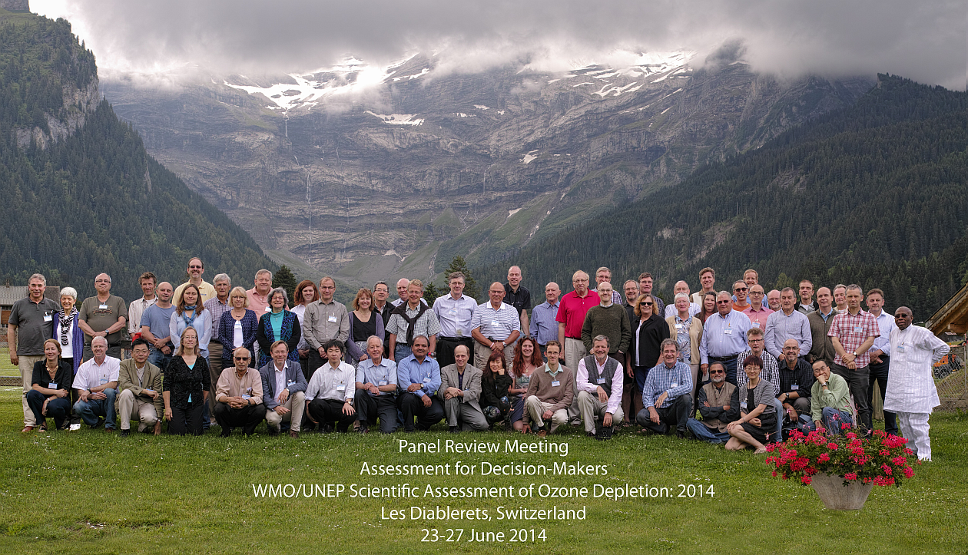
Long Term Trends in O3 - the 2018 WMO/UNEP Ozone Assessment Report

Slide 2








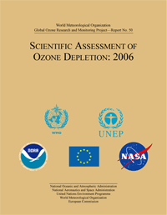
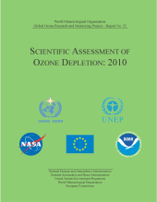
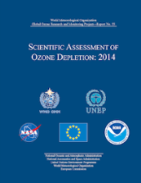



International Ozone Assessments
WMO .. Plan …
Ozone - 1977
Vienna Convention – 1985 (Art. 3)
Montreal Protocol -1987 (Art. 6)
1980
1990
2000
2010
2020
WMO The Stratosphere 1981: Theory and Measurements
WMO Atmospheric Ozone - 1985
WMO/UNEP Scientific Assessment of Ozone Depletion:
1989, 1991, 1994, 1998, 2002, 2006, 2010, 2014, 2014
2018
WMO Report of the International
Ozone Trends Panel – 1988
Technology and Economic Assessment Panel
reports prior to 1981
primarily in USA
Environmental Effects Assessment Panel

Slide 3
WMO /UNEP Ozone Assessment 2018
Cochairs; Steering Committee; Secretary
D. Fahey, P. Newman, J. Pyle, B. Safari;
M. Chipperfield, D. Karoly, D. Kinnison, M. Ko, M. Santee; S. Doherty
Lead Authors; Chapter Editors
Chapter 1: ODSs and Other Gases
A. Engel, M. Rigby; Q. Liang, S. Reimann
Chapter 2: HFCs
S. Montzka, G. Velders; L. Kuijpers, B. Sturges
Chapter 3: Global Ozone
P. Braesicke, J. Neu; W. Steinbrecht, M. Weber
Chapter 4: Polar Ozone
U. Langematz, M. Tully; B. Randel, S. Solomon
Chapter 5: Ozone and Climate
A. Karpechko, A. Maycock; C. Cagnazzo, L. Polvani
Chapter 6: Options for Policymakers
L. Carpenter, J. Daniel; N. Harris, M. Prather
+ co-authors
+ contributors
+ reviewers

Slide 4
WMO /UNEP Ozone Assessment 2018 - timeline
Jan. 2017 Lead Authors & Chapter editors established
31. Mar 2017 Chapter teams & outlines established
4.-5. May 2017 1st meeting Panel + Lead Authors
15. Sep. 2017 1st order draft due
22. Nov. 2017 1st order draft reviewed
28. Feb. 2018 2nd order draft due
26.-29. Mar. 2018 Boulder Meeting: Chapter bullets, coordination, to do‘s
2. May 2018 3rd order drafts due
28. May 2018 3rd order drafts reviewed
31. May 2018 all input papers & reports must be published
25. June 2018 Chapters finalized
16.-20. July 2018 Les Diablerets Meeting: Finalize Chapters
+ Exec. Summary bullets
Sep. 2018 Executive Summary published
Late 2018 2018 Assessment published
assessment content confidential
&
embargoed until late 2018

Slide 5
Outline of this talk
Turnaround of ozone depleting substances (ODS), equivalent effective stratospheric chlorine (EESC) and ozone
Diagnosing ozone increases
Real-world difficulties
Latitude altitude patterns / regions of largest ODS sensitivity
Clearest signs for recovery
Expectations & attribution, need for model simulations
Lack of total ozone recovery: ODS vs. transport changes
Lower stratosphere, Tropical trends and tropospheric changes
Summary
my personal take
&
based on existing, published material
based on topics in assessment

Slide 6
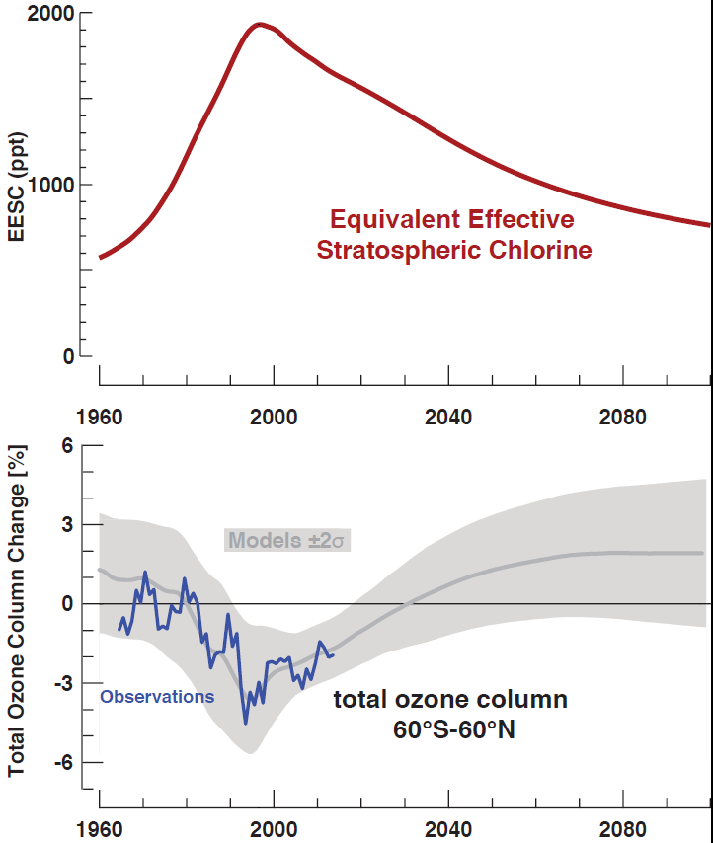

Montreal Protocol effective?
EESC ≈15% to 25% down from peak
Decline 3x slower!!
Is ozone responding & going up?
Due to ODS decline?
Due to transport & other changes?
WMO, 2014

Slide 7
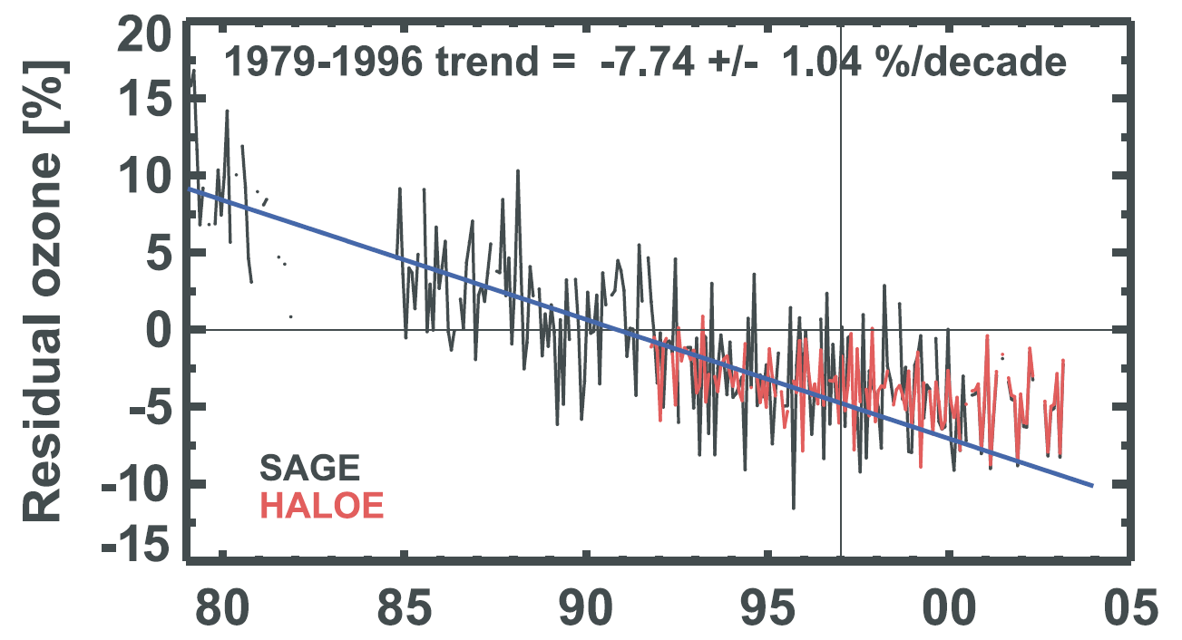

1.st stage of ozone recovery 2003
Newchurch et al. JGR 2003

Slide 8
Is ozone going up?
Multiple linear regression (e.g. Reinsel et al., JGR, 2005)
Dynamical linear model (e.g. Laine et al., ACP, 2014, Ball et al., ACP, 2018)
+reduce variability
-assumptions about sources & mechanisms

Slide 9
Is ozone going up?
Multiple linear regression (e.g. Reinsel et al., JGR, 2005)
Dynamical linear model (e.g. Laine et al., ACP, 2014, Ball et al., ACP, 2018)
+reduce variability
-assumptions about sources & mechanisms
Recovery ≈3x slower than decline
3x longer to detect (30 years?)
(e.g. Weatherhead et al., JGR, 2000)

Slide 10
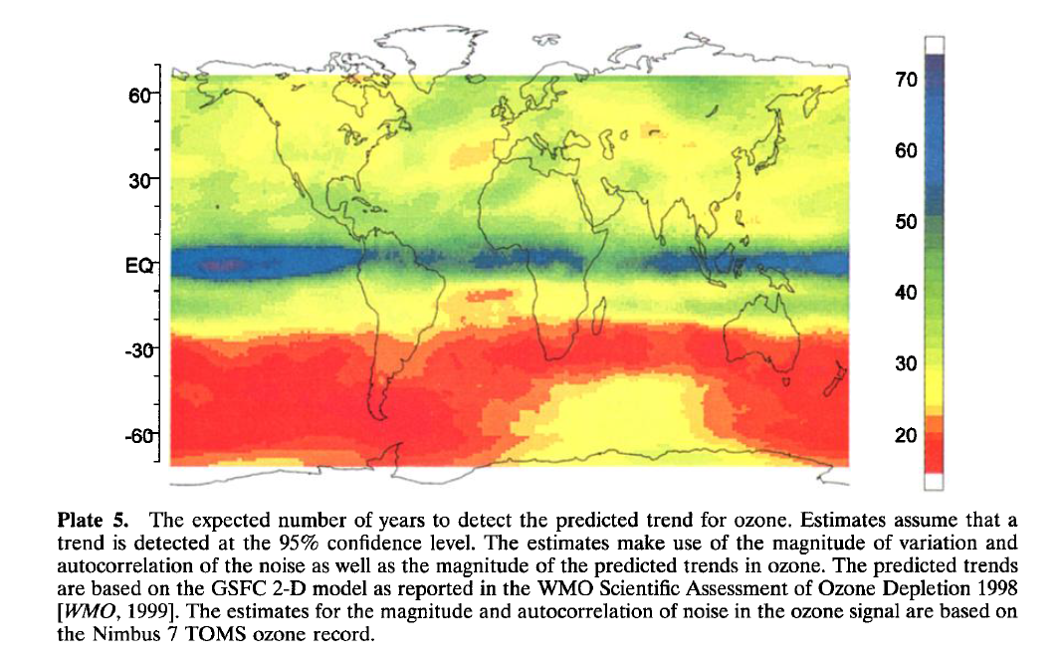
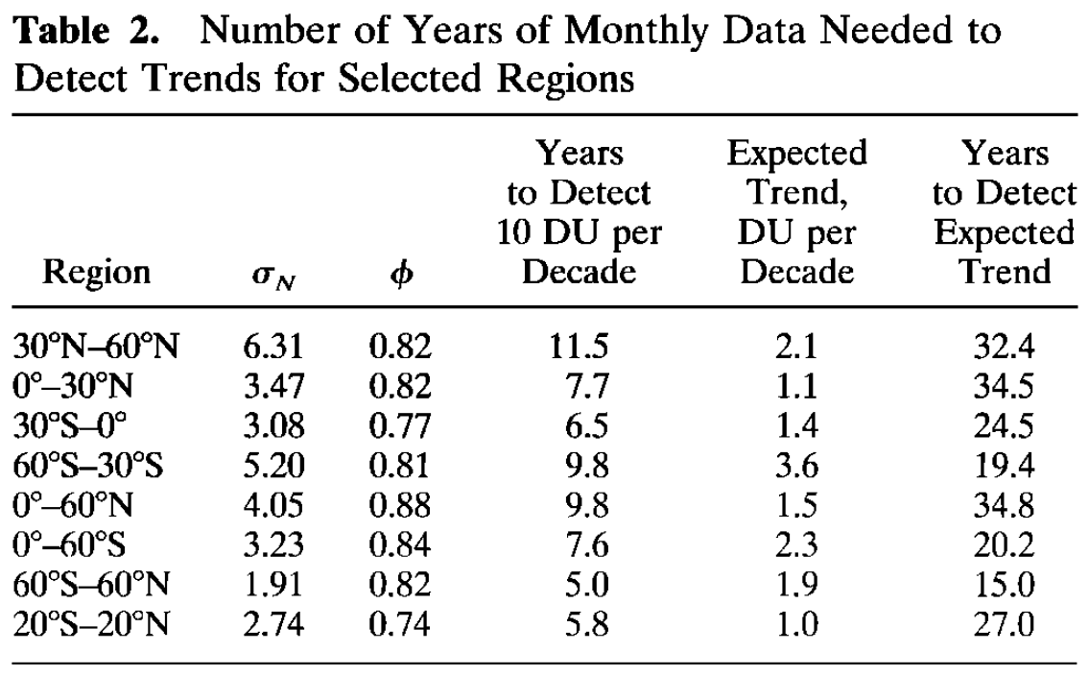
Time to detect trend
15 to 40 years
Weatherhead, JGR, 2000

Slide 11
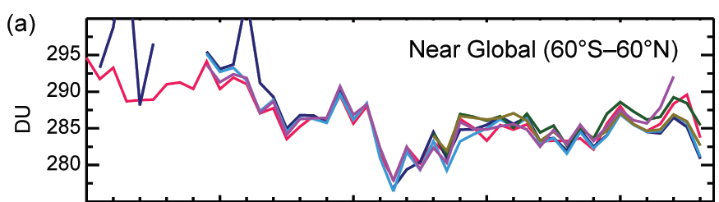
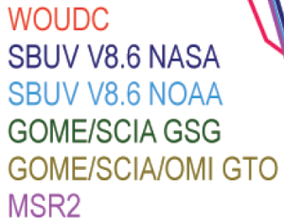
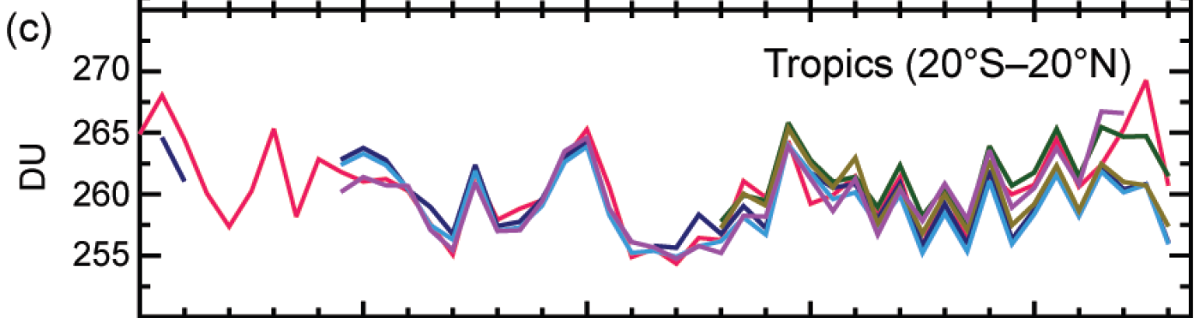
Complications – limited accuracy
2 to 4 DU, ≈1%
Weber et al., BAMS, 2017

Slide 12
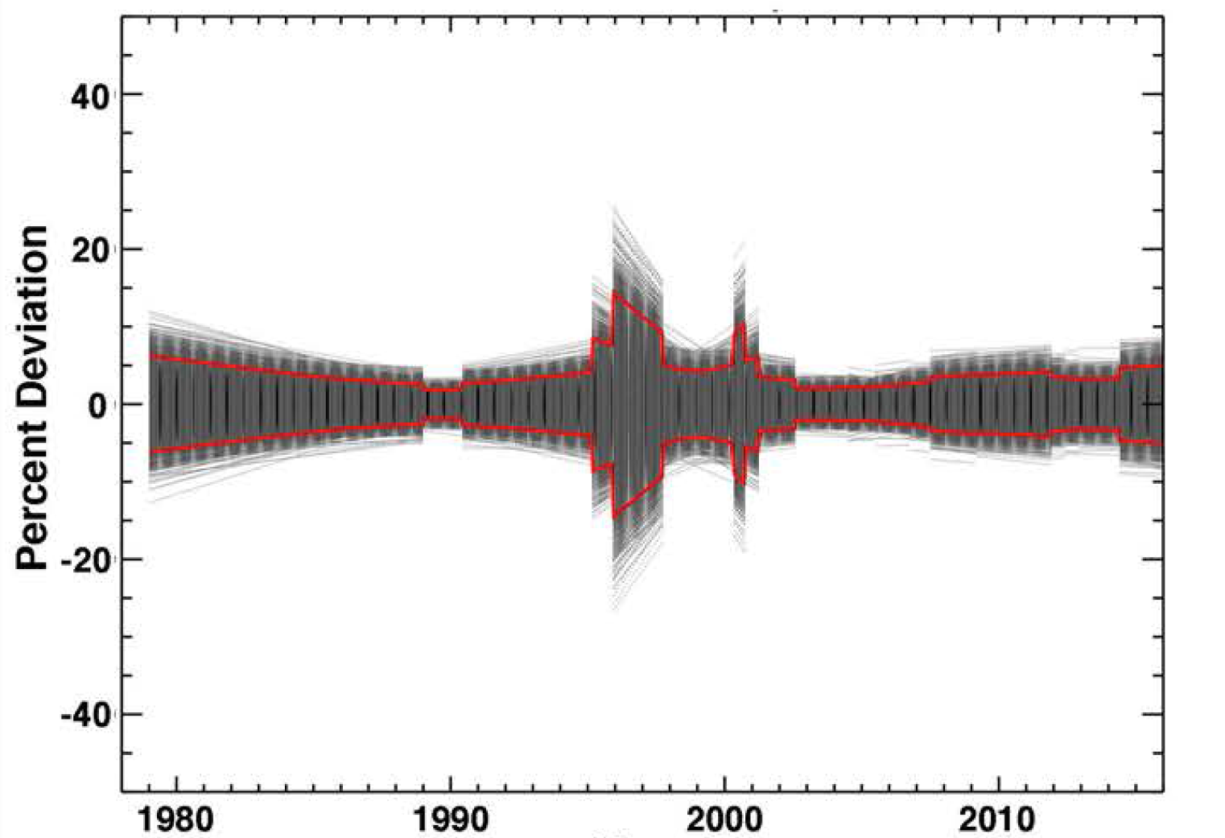
Complications – data merging
SBUV (v8.6) merged ozone data set(s)
≈3% / decade
Frith et al., ACPD, 2017

Slide 13
Detecting upward trends
Look for regions where:
trends / ODS effects are large
variability is low
measurements are good
clear trends in the past

Slide 14
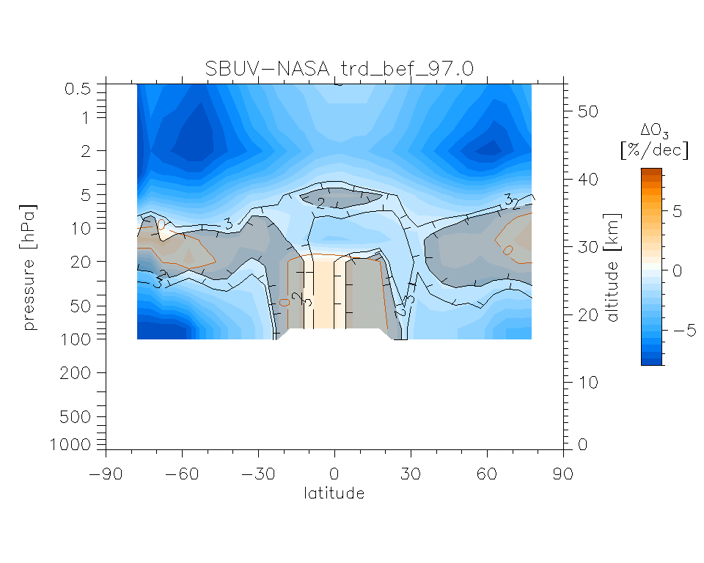
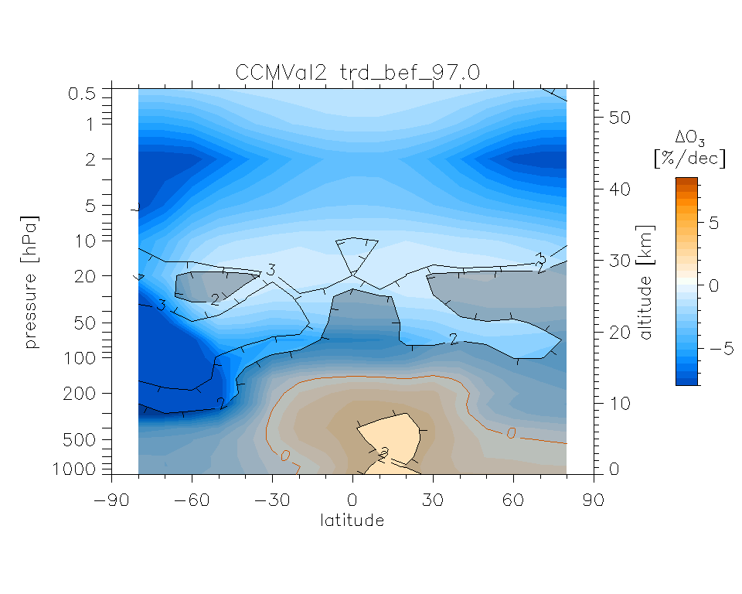
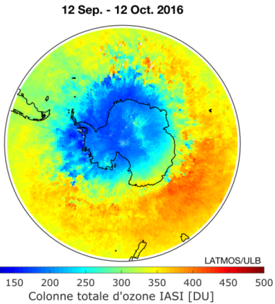
Look at the past
WMO, 2014
observed trend 1979 to 1997
modelled trend

Slide 15
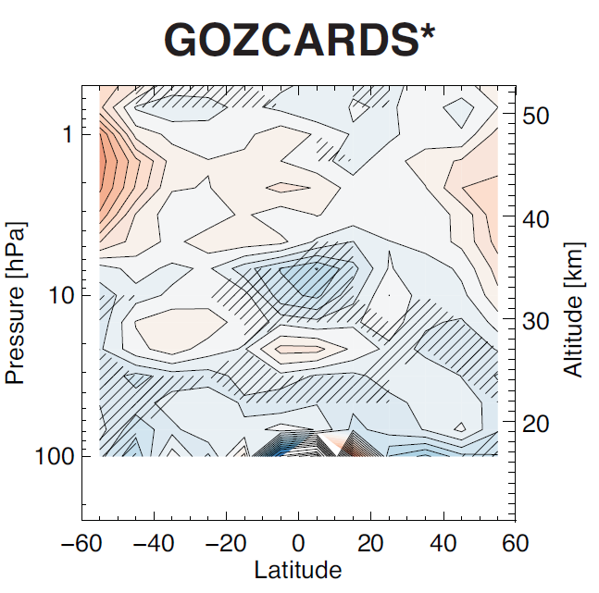
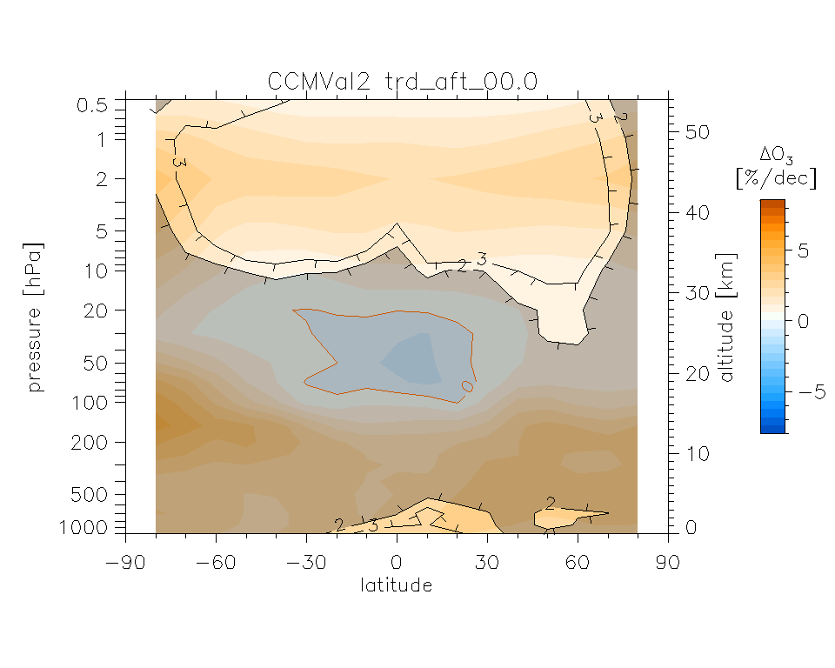
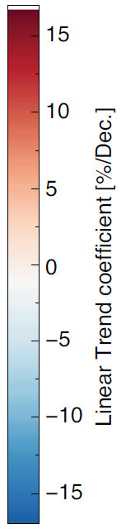
Ozone trends since 1997
1998 to 2012, SI2N, Harris et al., 2015
model simulated, WMO 2014

Slide 16
Ozone in upper stratosphere
NDACC: lidar, µWave, FTIR
merged satellites, CCMVal-2
Steinbrecht et al., ACP, 2017

Slide 17
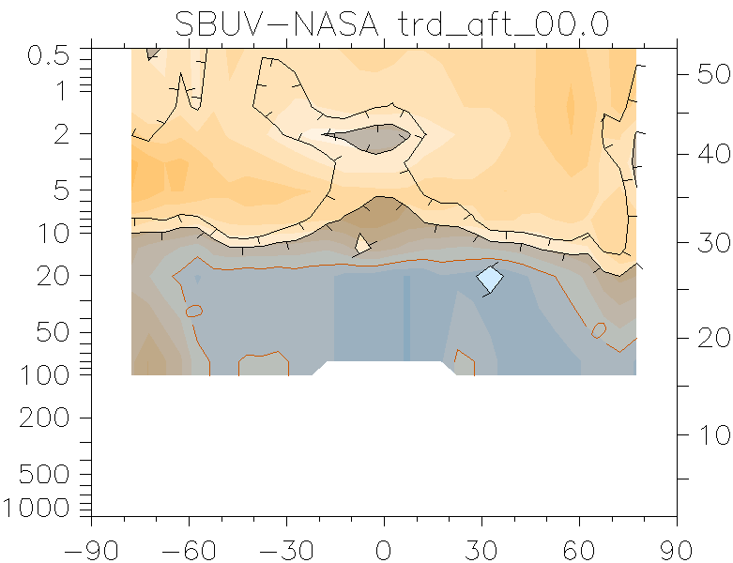
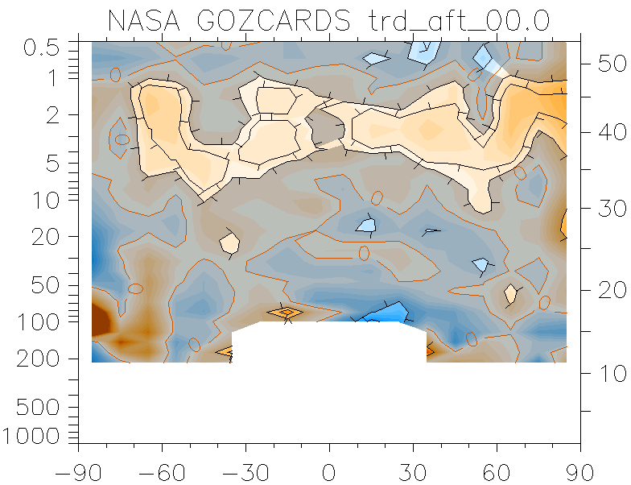
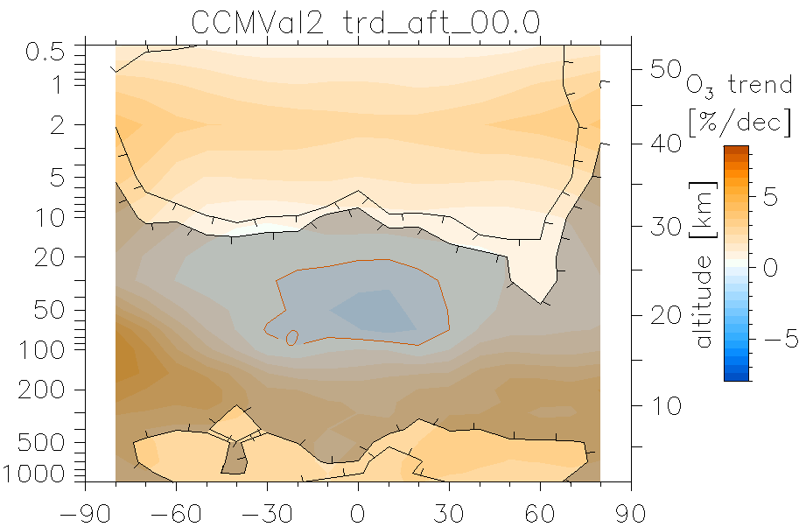
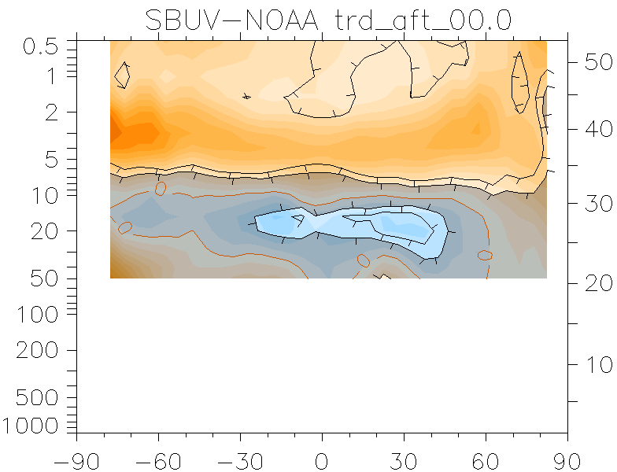
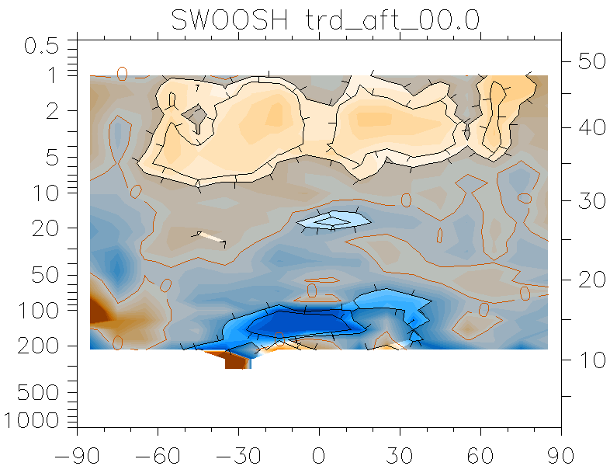
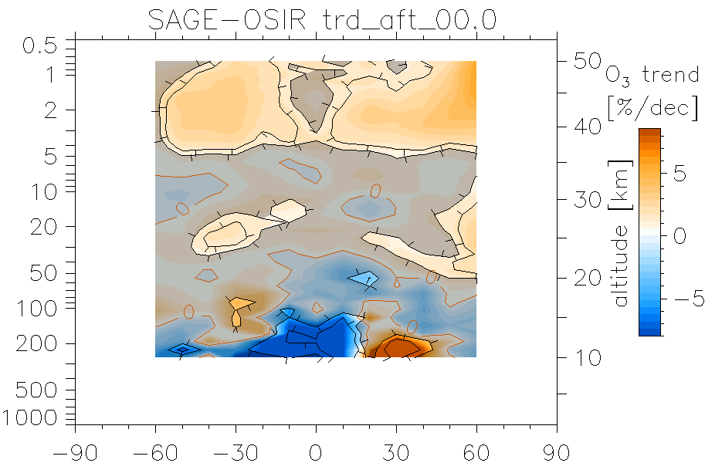
Ozone trends since 2000
2000 to 2016
SBUV-based
MLS-based
simulated
consistent pattern & magnitude
7 datasets, 4 instrument types
SBUV-based
MLS-based
OSIRIS-based
Steinbrecht et al., ACP, 2017

Slide 18
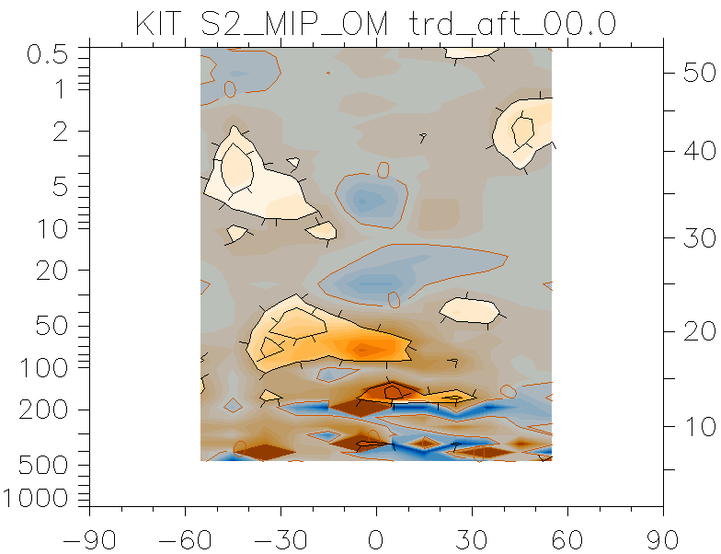
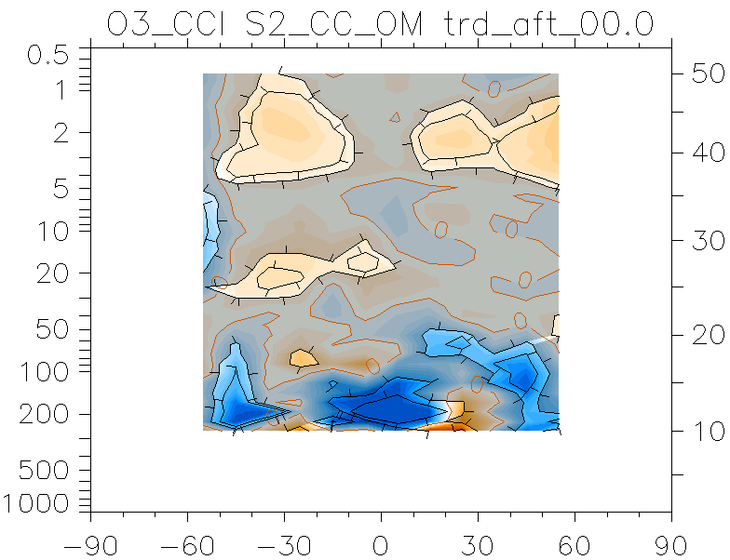
Ozone trends since 2000
2000 to 2016
MLS-based
simulated
MIPAS-based
consistent pattern & magnitude
7 datasets, 4 instrument types
ESA-CCI
MLS-based
OSIRIS-based
Steinbrecht et al., ACP, 2017

Slide 19
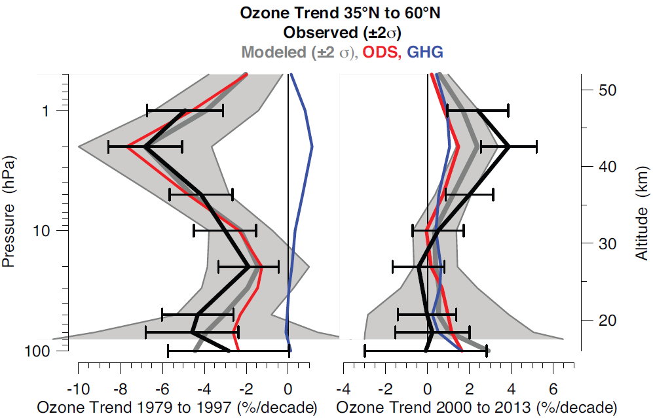
Increases upper stratosphere
(attributed)
significant increase since 2000
models:
½ ODS decline + ½ stratospheric cooling
(increasing CO₂ )
WMO, 2014
Steinbrecht et al., ACP, 2017

Slide 20
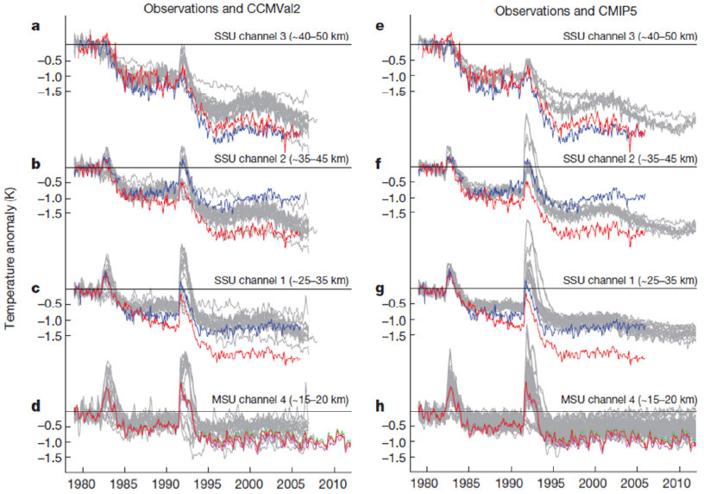
Strat. cooling due to CO₂ increase
Upper stratospheric cooling largely due to increasing CO₂ (traps IR from below, radiates to space)
Volcanoes!
Lower stratospheric cooling largely due to declining O3 (less heating)
?
NOAA
MetOffice
NOAA RSS UAH
Thompson et al. , Nature, 2012

Slide 21
Strat. cooling due to CO₂ increase
SSU 27/3 (Randel et al. JGR, 2009;
Wang & Zou, JClim, 2012) AMSU 14,13 (Funatsu, JGR, 2011)
MIPAS
Rockets (Dunkerton et al. JGR, 1998)
4 Lidars
CCMVAL1
Eyring et al., JGR, 2007

Slide 22
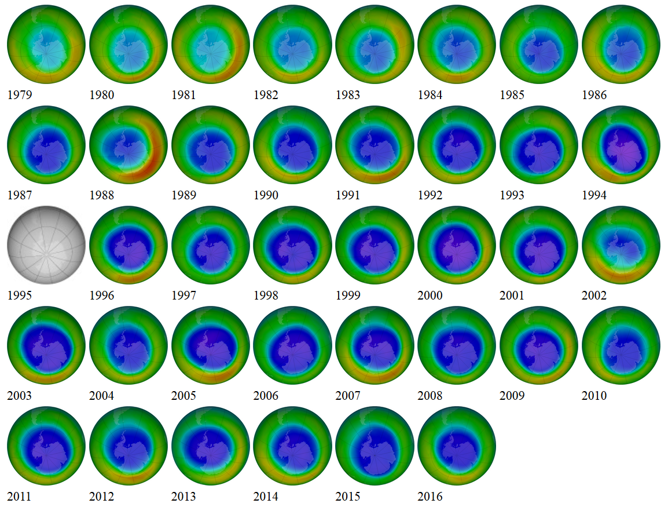
Increases over Antarctica?
September total ozone
ozonewatch.gsfc.nasa.gov

Slide 23
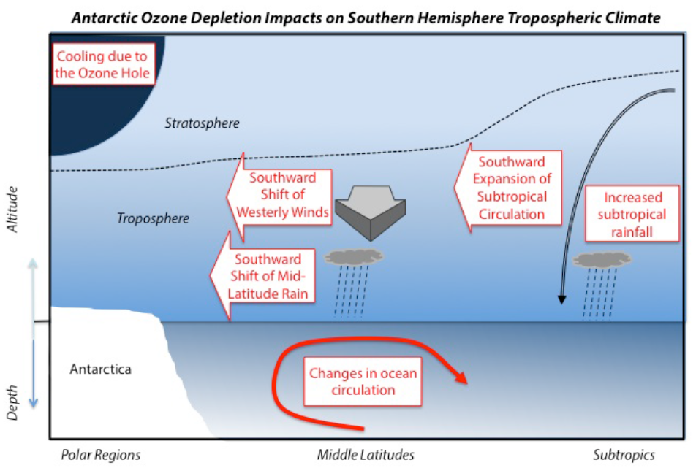
climate effects of ozone depletion
no clear effect in NH

Slide 24
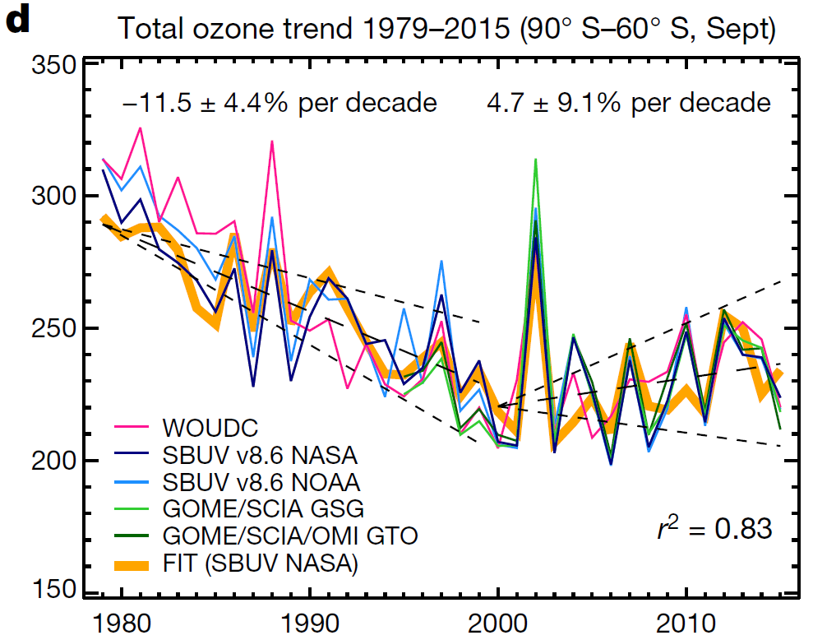
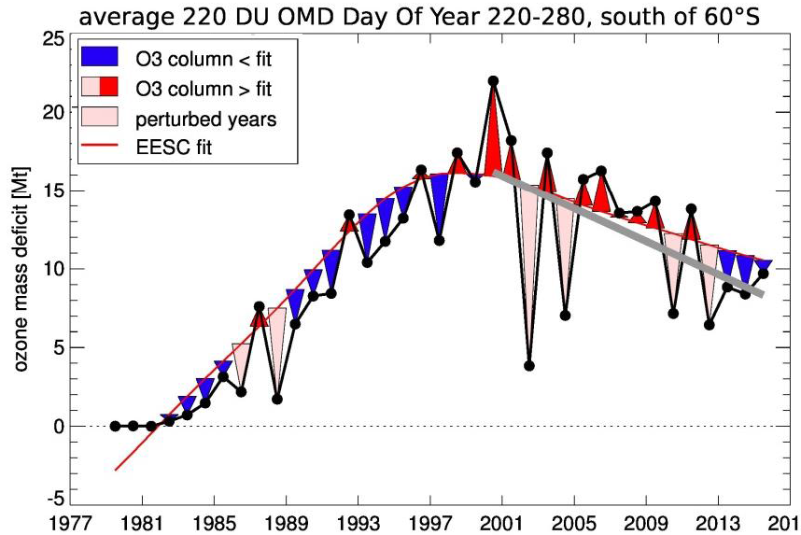
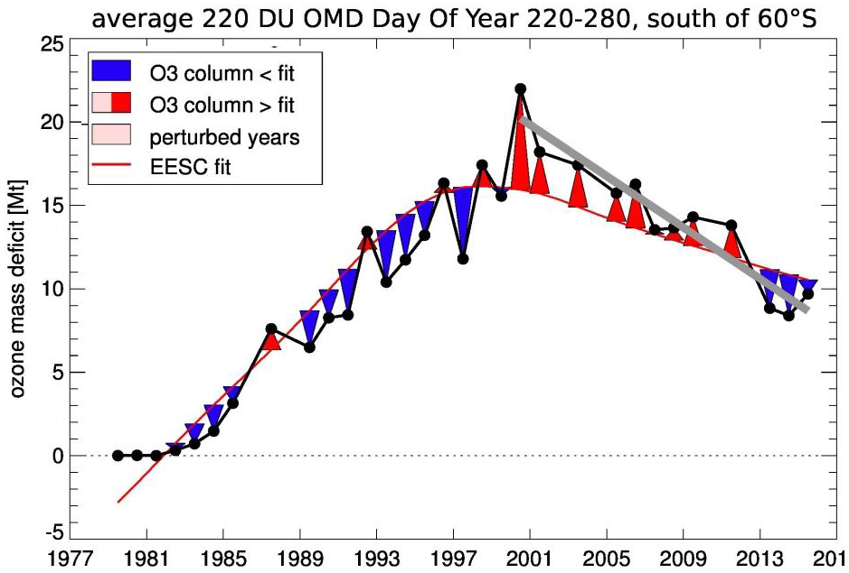


increases over Antarctica
Chipperfield et al., Nature, 2017
de Laat et al., QOS, 2016

Slide 25
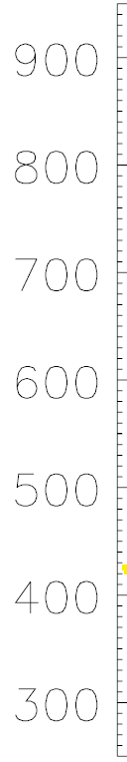
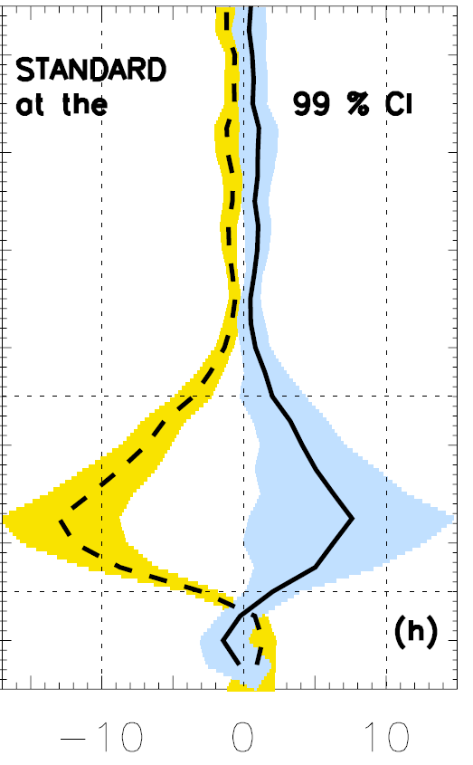
Increases over Antarctica
SON
2000 baseline
ozone increase
due to declining ODS?
increase/decline
≈0.33 !!
for ODS
Increase / decline
8 / 13 = 0.61
decline
until
2000
increase
since
2000
potential temperature [K]
O₃ trend [%/year]
Kuttipurath & Nair, Nature, 2017

Slide 26
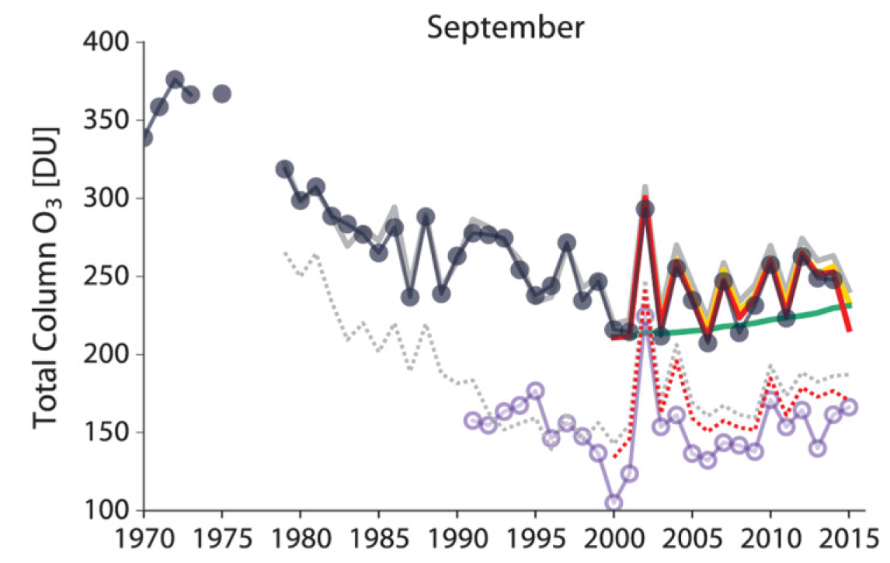
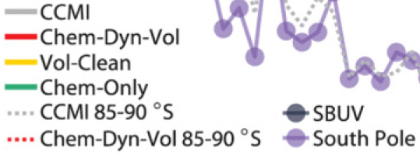
Increases over Antarctica
(attributed)
Increase / decline
47 DU/dec / 27 = 0.6
should be 0.33 !!
other: 20 DU
ODS: 20 DU
significant increase since 2000
due to
ODS decline + transport changes
Solomon et al., Science 2016

Slide 27
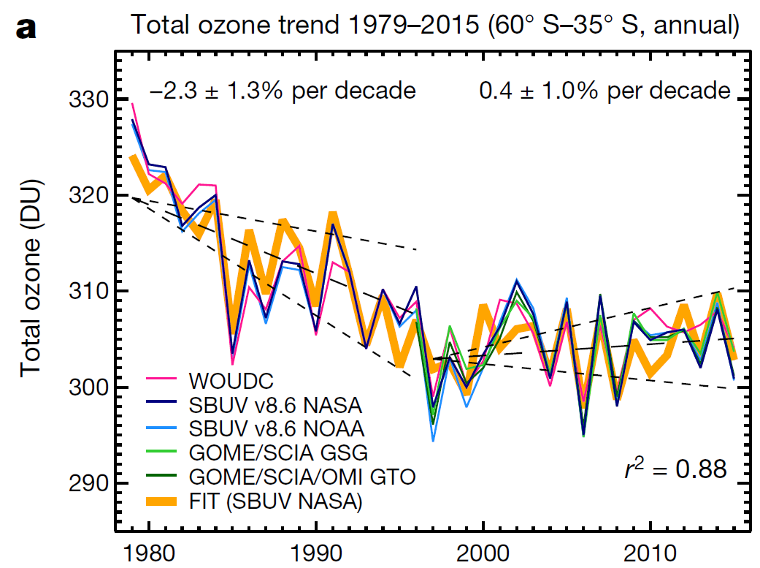
Total ozone ≈constant
No significant increase
Chipperfield et al., Nature, 2017; Weber et al., ACPD, 2017

Slide 28
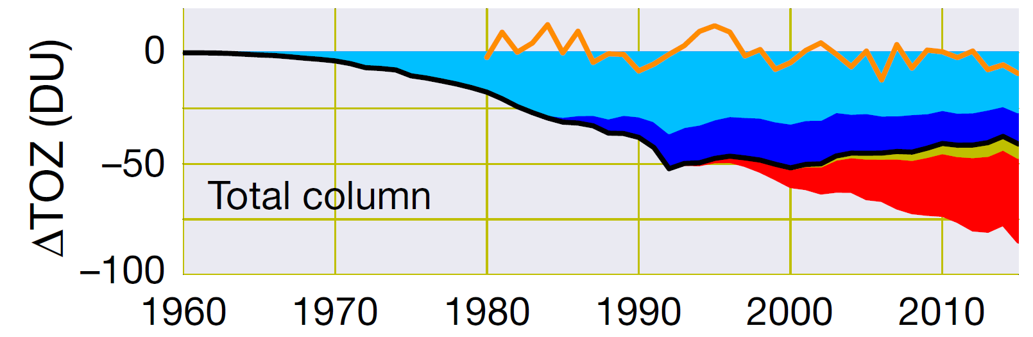
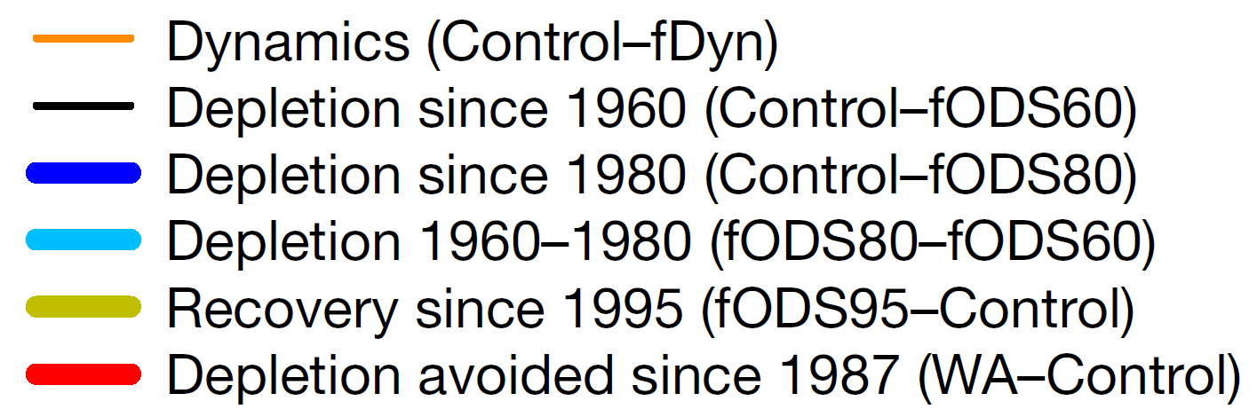
Model simulations (TOMCAT-CTM)
-10 DU transport change
60°S to 35°S
+12 DU „chemical“ recovery
Chipperfield et al., Nature, 2017

Slide 29
Model simulations (TOMCAT-CTM)
-10 ± 5 DU transport change
+12 ± 3 DU „chemical“ change
=========================
+2 ± 6 DU net change
+0.35 ± 1% per decade (300 DU, 20 years)
60°S to 35°S, ≈2000 to ≈ 2015

Slide 30
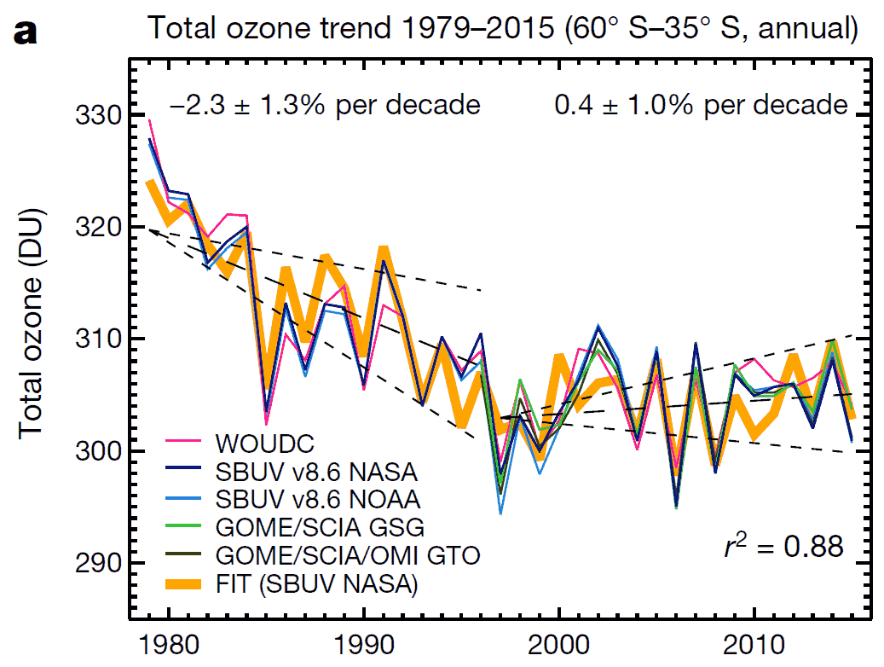
Model simulations (TOMCAT-CTM)
60°S to 35°S
Chipperfield et al., Nature, 2017

Slide 31
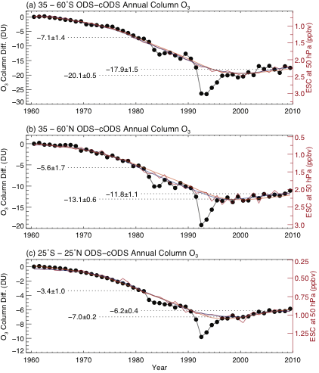
Models differ!!
60°S to 35°S
Obs -18 DU
CMAM -10 DU
TOMCAT -25 DU
Chipperfield et al., Nature, 2017
Shepherd et al., Nature Geosc., 2014

Slide 32
Recovery of total ozone
decline ended in mid-1990s (Montreal worked!)
no significant increases since
(small) chemical increases offset by (decadal) transport changes?
unexpected for increased Brewer Dobson circulation?
continuing decline in lower stratosphere? (Ball et al. ACP 2018)
di-chloro methane unlikely (Hossaini et al., Nature, 2017: 2 DU / 50 years = 0.2 DU / decade = 0.07% / decade)

Slide 33
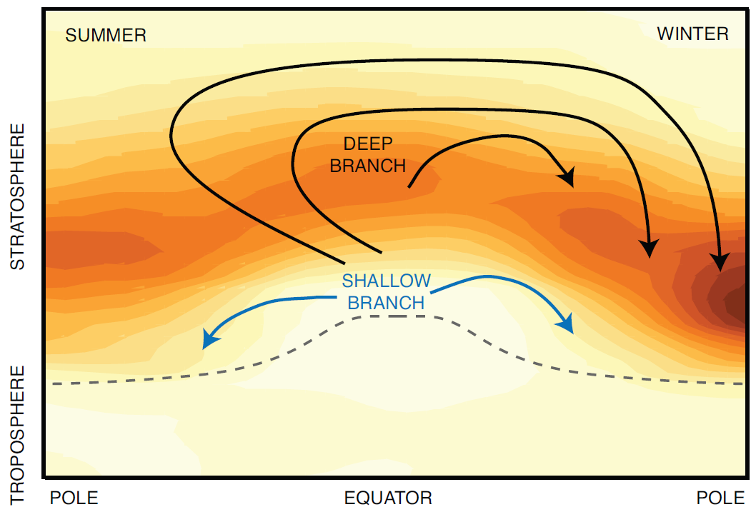
Brewer Dobson Circulation
Models simulate increasing BDC on 50 to 100 year time-scale
upwelling

Slide 34
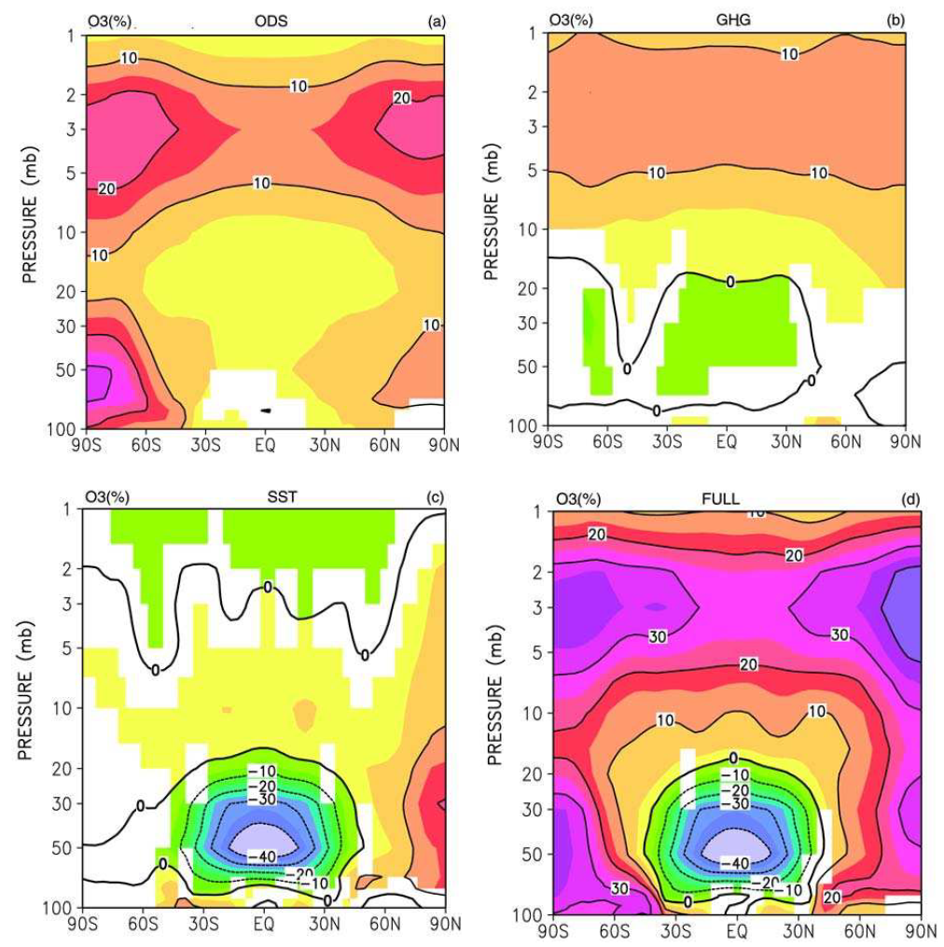
drivers of (future) ozone changes
ODS
O₃(2100) – O₃(2000)
CO₂ cooling
Less ODS → more O₃
more CO₂ → strat. cools → more O₃
more GHG → troposphere warms → enhanced ascent in tropics → enhanced waves → enhanced BDC
larger ozone columns at higher latitudes
smaller ozone columns in tropics?
BDC changes
FULL
Zubov et al. 2012

Slide 35
drivers of (future) ozone changes
ODS
O₃(2100) – O₃(2000)
CO₂ cooling
Less ODS → more O₃
more CO₂ → strat. cools → more O₃
more GHG → troposphere warms → enhanced ascent in tropics → enhanced waves → enhanced BDC
larger ozone columns at higher latitudes
smaller ozone columns in tropics?
trop. warming
FULL
Zubov et al. 2012

Slide 36
Tropical ozone – no ODS, but climate
Models simulate increasing BDC – declining ozone in tropical LS

Slide 37
Tropical ozone – no ODS, but climate
Models simulate increasing BDC – declining ozone in tropical LS

Slide 38
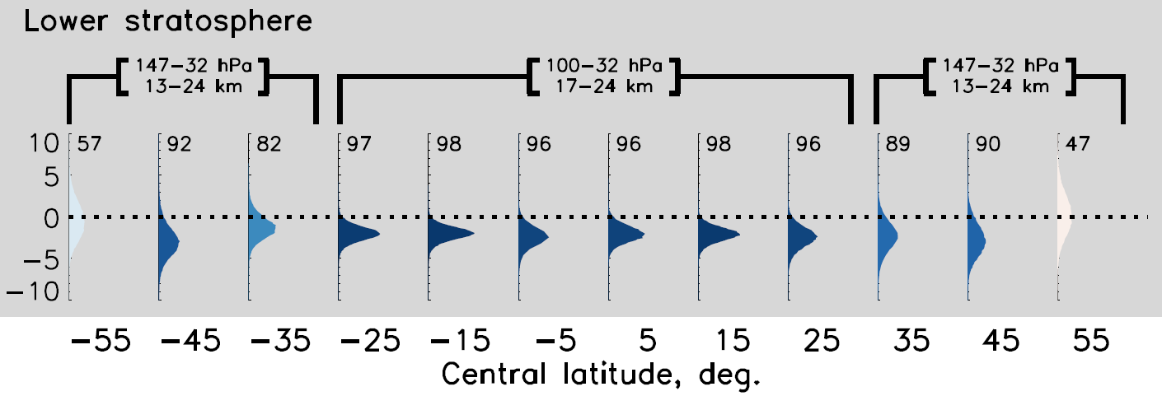
ozone in lower stratosphere
2016 - 1998, GOZCARDS + SWOOSH
ΔO3 [DU]
predicted for 30°S to 30°N
but no increase seen at higher latitudes !
what is going on ?
Ball et al., ACP 2018

Slide 39
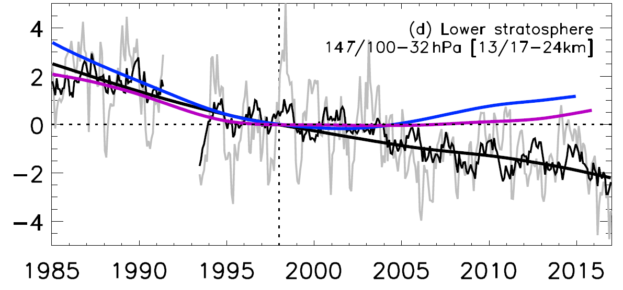
ozone in lower stratosphere
GOZCARDS + SWOOSH, regression
WACCM, SOCOL
ΔO3 [DU]
← SAGE 2 →
← MLS →
Ball et al., ACP 2018

Slide 40
changes in BDC
predictions are for 100 years
observations are for 10 to 20 years
decadal variations matter (a lot)
direct observations do not exist
the BDC is a complex 4-D beast

Slide 41
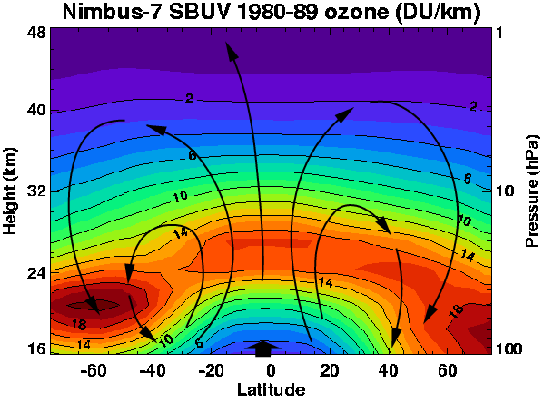
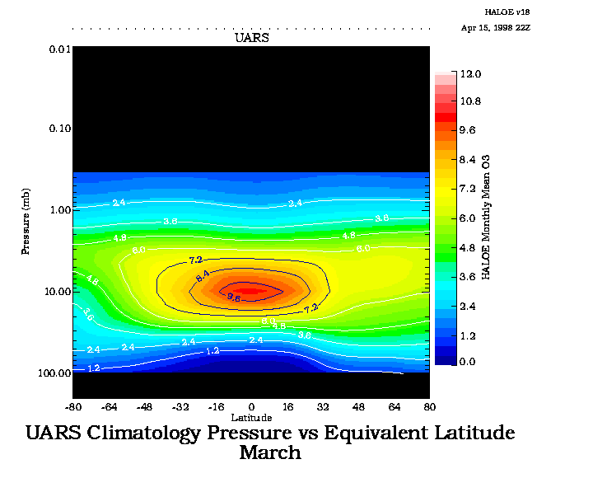
global ozone distribution &
Brewer-Dobson circulation
HALOE climatology March [ppmv]
600 K
395 K

Slide 42
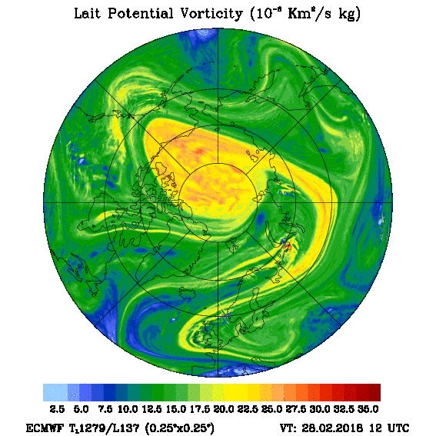
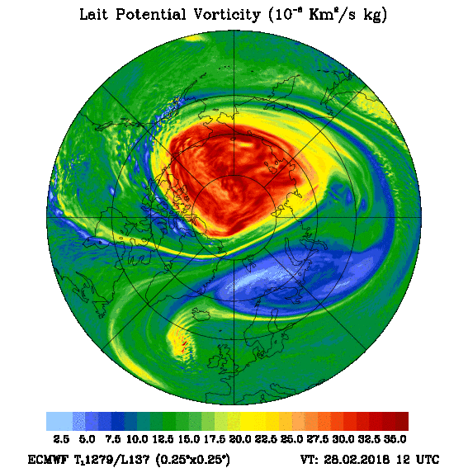
395 K ~ 120 hPa ~ 17 km
600 K ~ 30 hPa ~ 27 km
Dörnbrack, https://www.pa.op.dlr.de/arctic

Slide 43


395 K ~ 120 hPa ~ 17 km
600 K ~ 30 hPa ~ 27 km
Dörnbrack, https://www.pa.op.dlr.de/arctic

Slide 44


395 K ~ 120 hPa ~ 17 km
600 K ~ 30 hPa ~ 27 km
Dörnbrack, https://www.pa.op.dlr.de/arctic

Slide 45


395 K ~ 120 hPa ~ 17 km
600 K ~ 30 hPa ~ 27 km
Dörnbrack, https://www.pa.op.dlr.de/arctic

Slide 46


395 K ~ 120 hPa ~ 17 km
600 K ~ 30 hPa ~ 27 km
Dörnbrack, https://www.pa.op.dlr.de/arctic

Slide 47


395 K ~ 120 hPa ~ 17 km
600 K ~ 30 hPa ~ 27 km
Dörnbrack, https://www.pa.op.dlr.de/arctic

Slide 48


395 K ~ 120 hPa ~ 17 km
600 K ~ 30 hPa ~ 27 km
Dörnbrack, https://www.pa.op.dlr.de/arctic

Slide 49


395 K ~ 120 hPa ~ 17 km
600 K ~ 30 hPa ~ 27 km
Dörnbrack, https://www.pa.op.dlr.de/arctic

Slide 50


395 K ~ 120 hPa ~ 17 km
600 K ~ 30 hPa ~ 27 km
Dörnbrack, https://www.pa.op.dlr.de/arctic

Slide 51


395 K ~ 120 hPa ~ 17 km
600 K ~ 30 hPa ~ 27 km
Dörnbrack, https://www.pa.op.dlr.de/arctic

Slide 52


395 K ~ 120 hPa ~ 17 km
600 K ~ 30 hPa ~ 27 km
Dörnbrack, https://www.pa.op.dlr.de/arctic

Slide 53


395 K ~ 120 hPa ~ 17 km
600 K ~ 30 hPa ~ 27 km
Dörnbrack, https://www.pa.op.dlr.de/arctic

Slide 54


395 K ~ 120 hPa ~ 17 km
600 K ~ 30 hPa ~ 27 km
Dörnbrack, https://www.pa.op.dlr.de/arctic

Slide 55


395 K ~ 120 hPa ~ 17 km
600 K ~ 30 hPa ~ 27 km
Dörnbrack, https://www.pa.op.dlr.de/arctic

Slide 56


395 K ~ 120 hPa ~ 17 km
600 K ~ 30 hPa ~ 27 km
Dörnbrack, https://www.pa.op.dlr.de/arctic

Slide 57


395 K ~ 120 hPa ~ 17 km
600 K ~ 30 hPa ~ 27 km
Dörnbrack, https://www.pa.op.dlr.de/arctic

Slide 58


395 K ~ 120 hPa ~ 17 km
600 K ~ 30 hPa ~ 27 km
Dörnbrack, https://www.pa.op.dlr.de/arctic

Slide 59


395 K ~ 120 hPa ~ 17 km
600 K ~ 30 hPa ~ 27 km
Dörnbrack, https://www.pa.op.dlr.de/arctic

Slide 60


395 K ~ 120 hPa ~ 17 km
600 K ~ 30 hPa ~ 27 km
Dörnbrack, https://www.pa.op.dlr.de/arctic

Slide 61


395 K ~ 120 hPa ~ 17 km
600 K ~ 30 hPa ~ 27 km
Dörnbrack, https://www.pa.op.dlr.de/arctic

Slide 62


395 K ~ 120 hPa ~ 17 km
600 K ~ 30 hPa ~ 27 km
Dörnbrack, https://www.pa.op.dlr.de/arctic

Slide 63


395 K ~ 120 hPa ~ 17 km
600 K ~ 30 hPa ~ 27 km
Dörnbrack, https://www.pa.op.dlr.de/arctic

Slide 64


395 K ~ 120 hPa ~ 17 km
600 K ~ 30 hPa ~ 27 km
Dörnbrack, https://www.pa.op.dlr.de/arctic

Slide 65


395 K ~ 120 hPa ~ 17 km
600 K ~ 30 hPa ~ 27 km
Dörnbrack, https://www.pa.op.dlr.de/arctic

Slide 66


395 K ~ 120 hPa ~ 17 km
600 K ~ 30 hPa ~ 27 km
Dörnbrack, https://www.pa.op.dlr.de/arctic

Slide 67


395 K ~ 120 hPa ~ 17 km
600 K ~ 30 hPa ~ 27 km
Dörnbrack, https://www.pa.op.dlr.de/arctic

Slide 68


395 K ~ 120 hPa ~ 17 km
600 K ~ 30 hPa ~ 27 km
Dörnbrack, https://www.pa.op.dlr.de/arctic

Slide 69


395 K ~ 120 hPa ~ 17 km
600 K ~ 30 hPa ~ 27 km
Dörnbrack, https://www.pa.op.dlr.de/arctic

Slide 70


395 K ~ 120 hPa ~ 17 km
600 K ~ 30 hPa ~ 27 km
Dörnbrack, https://www.pa.op.dlr.de/arctic

Slide 71


395 K ~ 120 hPa ~ 17 km
600 K ~ 30 hPa ~ 27 km
Dörnbrack, https://www.pa.op.dlr.de/arctic

Slide 72
Tropical ozone columns ??
Models simulate increasing BDC on 50 to 100 year time-scale
upwelling

Slide 73

Tropical ozone columns
Chipperfield et al., Nature, 2017

Slide 74

Tropical ozone trends
Shepherd et al., NGEO, 2014
stratospheric decrease
compensated by
tropospheric increase?

Slide 75

tropospheric increase?
OMI-MLS
Ball et al., ACP, 2018
1 DU / decade
Shepherd et al., NGEO, 2014

Slide 76

tropospheric increase?
different data-sets
very different tropospheric ozone trends
!!TOAR talk coming up!!
OMI-MLS
Ball et al., ACP, 2018
OMI-MLS
OMI, RAL
GOME, OMI
IASI, FORLI
IASI, SOFRID
SCIAMACHY
Barret et al., TOAR, 2018

Slide 77
Summary
Ozone is recovering in upper stratosphere
  patterns & magnitude consistent with expectations
  ODS + CO₂ as in WMO 2014
Antarctic Sept. increase
  larger than expected from ODS decline!!
Column ozone: no clear increases yet
  ≈ expected (takes 20 to 40 years!)
  „chemical“ increase offset by (unexpected) transport decline?
  tropospheric changes?
to see actual recovery: need 1% accuracy, long-term observations & simulations

Slide 78
Summary
Ozone is recovering in upper stratosphere
  patterns & magnitude consistent with expectations
  ODS + CO₂ as in WMO 2014
Antarctic Sept. increase
  larger than expected from ODS decline!!
Column ozone: no clear increases yet
  ≈ expected (takes 20 to 40 years!)
  „chemical“ increase offset by (unexpected) transport decline?
  tropospheric changes?
to see actual recovery: need 1% accuracy, long-term observations & simulations
WMO 2018 vs. WMO 2014 (my take!!)
no large surprises – similar conclusions
HFC chapter (reflecting Kigali 2016)
Some ODS emissions still unclear (CFC11, CCl4)
CCMI (replaces CCMVal2)
LOTUS (upper strat. recovery)
signs of Antarctic recovery
total ozone / lower strat. / BDC still complicated
no clear signs for increasing total ozone
more interest in tropospheric ozone

Slide 79

Recovery
patient still sick
keep checking
don‘t stop caring

Slide 80


climate benefits of the Montreal Protocol
2014
40 Gt
avoided CFCs = avoided greenhouse gases
CO₂ [Gt / yr]
50% of CO₂ em.
7% of CO₂ em.
30
0
1970
2010

Slide 81
climate benefits of the Montreal Protocol
avoided CFCs = avoided greenhouse gases
50% of CO₂ em.
7% of CO₂ em.

Slide 82

climate benefits of the Montreal Protocol
HFCs could be a problem!
50% of CO₂ emissions
7% of CO₂ em.
radiative forcing ≈ integrated emissions

Slide 83


future ozone: drivers
  ODS deplete O3
  CO₂ cools
  N₂O depletes O₃
  CH₄ increases O₃
Fleming ACP 2011, Portmann RoySoc 2012

